Slide 1
Test-Driven
Development
Tomas van Rietbergen - 2023
Notes:
Also known as TDD
We're going to discuss what it is and what it is not,
and also what it's good at and what it's not good at

Slide 2

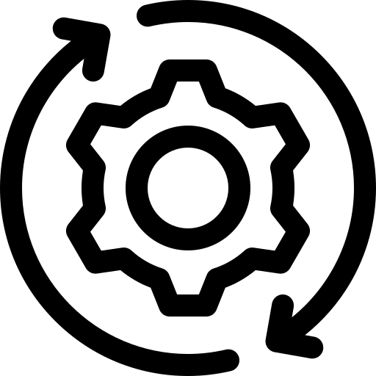

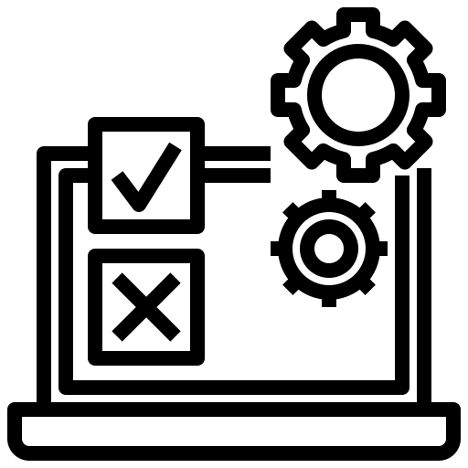
Outline
What is TDD and why use it
The TDD Process
Effectiveness of TDD
Designing for Testability
Notes:
roughly divided into 4 section
We start with the general introduction
what it is and why should care
Quickly go through TDD process with an example as a refresher
After that we'll look at some empirical studies on TDD and its effectiveness
Lastly, I will go over how some more advanced topics regarding design and testability

Slide 3
What is Test-Driven Development
“Test-Driven Development (TDD) is a technique for building software that guides software development by writing tests.”
- Martin Fowler
Test-After Development
Test-Driven Development
Design
Code
Test
Design
Test
Code
Notes:
So, What is test-driven development
Martin Fowler gave following definition states that
TDD is a method for developing software, NOT just testing software,
which is guided by writing tests
In the traditional test-after approach implementation first
but with TDD we write our tests before the implementation
so already test in place that tell you what the implementation should do

Slide 4
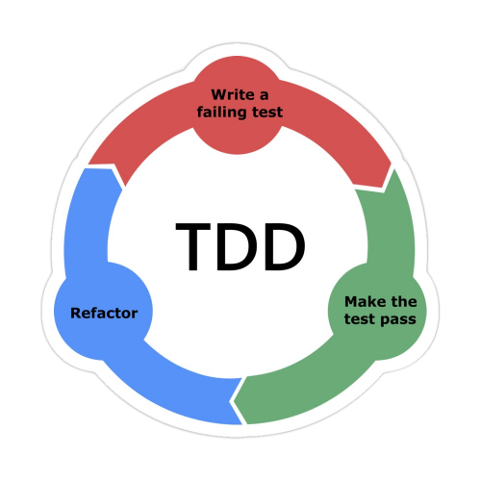
The Three Laws of TDD
You may not write production code unless you've written a failing test first
You may not write more of a unit test than is sufficient to fail
You may not write more production code than is sufficient to make the failing unit test pass
Notes:
Proper TDD adheres to the following three laws.
1
2
this last point is where a lot of developers get disturbed
sometimes this means writing an implementation that you know is wrong
but it still allows you to pass the current test
and your future tests will have to make sure you eventually come to the correct implementation

Slide 5
Test-Driven Development - An Analogy
Test-After Development
Test-Driven Development
Build any number of floors
Define requirements for new floors
Test floors for requirements
Previous steps might be unstable causing collapse
Define requirements for single new floor
Build a single floor at a time (The bare minimum, no extras)
Test floors for requirements
Once stable, improve the new floor and add extras
Notes:
TODO: Image of crane building here
TDD is really about steady, incremental progress.
Whereas in test-after we might implement and test a big chunk of work at once, in TDD we do it in small but confident steps.
TDD reduces the likelihood that we need to go back and fix things and also makes it easier to fix things, since we know the last change broke something.

Slide 6
Why Test-Driven Development?
“Test-first code tends to be more cohesive and less coupled than code in which testing isn’t a part of the intimate coding cycle”
- Kent Beck
Instant feedback
Faster debugging, more confidence
Squash larvae instead of hunting mature bugs
Better development practices
Drive writing testable code
Decompose into manageable tasks
Tests always up-to-date
Tests themselves are also tested!
Increased value of tests as documentation
Notes:
Now that we have a definition for TDD, let's look at why you would use it in the first place
Just to be clear, this presentation is not going to be a pure advertisement for TDD. Rather, I want to discuss the pros and cons
One of the main benefits is Instant feedback: we want our feedback loops to be a short as possible
Running test frequently, catch defects early, last change, more confidence as tests are passing
If you write a big chunk of implementation first, it can be hard to properly test all of your code
By writing the tests first you are driven to write testable code from the start, instead of trying to squeeze them in later
It also encourages decomposing the problem into manageable tasks, one small test at a time
Safer refactoring as you have already tests in place
While non-TDD tests can also serve as documentation
TDD tests may do a better job at capturing the original intentions
When you go into new code you don't know much about implementation yet
Non-TDD test may focus more on validating the code rather than specifying its requirements.

Slide 7
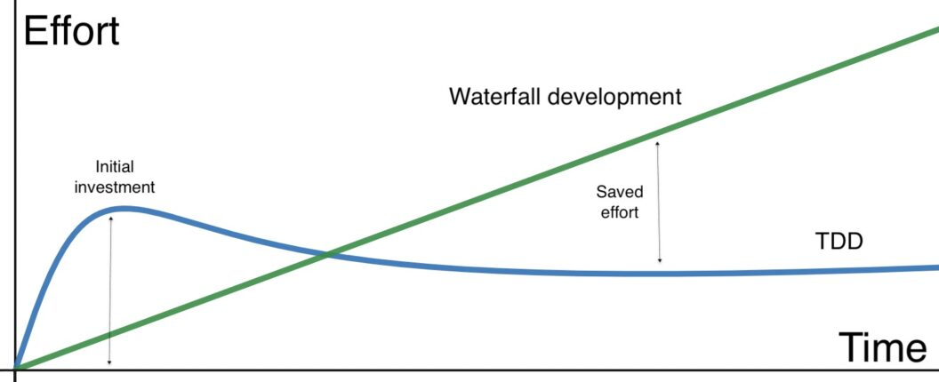
But!
Waterfall
We don't have the time or money!
Short-term loss, long-term gain
Bugs in production are costly
I am already writing unit tests…
Sometimes happy path only
In practice fewer total tests
TDD feels too restricting and unnatural
Rules can be adjusted
Initial Investment
Savings
TDD
Notes:
These are some common objections to TDD
Most and foremost, we don't have the time or money for TDD
With TDD you have an initial investment,
but this should eventually pay out in the long run because of less debugging
And bugs in production can be very costly
Another argument is, I am already writing unit tests!
Tests are usually different with test after, Often just the happy path is tested
Also, in practice test-after usually ends up with less tests than TDD
After the product has been implemented and shipped it's unlikely unit tests are going to be written
For some people TDD feels to restricting,
but like any other tool, there is some leeway and it's okay to adjust the granularity a bit to your liking
Later on we're going to discuss the actual effects and costs

Slide 8
The TDD Process
Notes:
now, A quick refresher on the TDD process

Slide 9
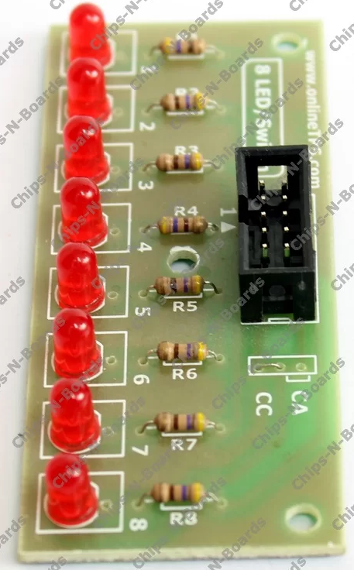
The TDD process
LED example
Define a test list
Add a small failing test
Implement minimal code
Make the test pass
Refactor
Notes:
For this example we have a an array of LEDs
and we want to implement some driver functionality with TDD

Slide 10
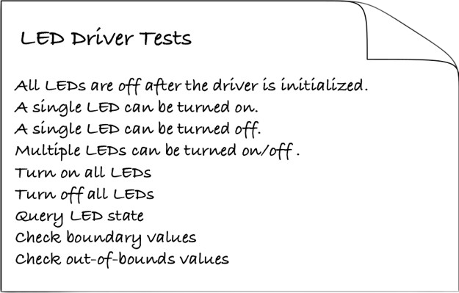
The TDD process
Define a test list
Add a small failing test
Implement minimal code
Make the test pass
Refactor
James W. Grenning - Test Driven Development for Embedded C
Notes:
The first step is to define a test list
With all the relevant tests that you can think of currently
These can also be deduced from a requirement specification
May evolve as we implement features

Slide 11
The TDD process
TEST(LedDriver, TurnOnLedOne)
{
LedDriver_TurnOn(1);
TEST_ASSERT_EQUAL_HEX16(1,virtualLeds);
}
Define a test list
Add a small failing test
Implement minimal code
Make the test pass
Refactor
void LedDriver_TurnOn(int ledNumber)
{
}
1 Tests 1 Failures 0 Ignored
Notes:
By failing the test first we also confirm that the test doesn't give a false positive, thus we test the test
These simple implementations test our tests.
Watching the test case fail shows that the test can detect a wrong result.
EXTRA:
In essence, we’re closing a vice around the code under test,
holding the behavior steady (see the sidebar on the following page).
Don’t worry, the production code won’t be hard-coded and incomplete
for long. As soon as you need to turn on a different LED, the hard-coded value will have to go.
The real implementation is not much more diffi-
cult, but I ask you to resist the temptation to put in more code than is
needed by the current test. We’re evolving the design. The problem with
adding more code than the current tests require is that you probably
won’t write all the tests you need to keep future, and present, bugs out
of the code.
Adding code before it is needed by the tests adds complexity. Sometimes
you will be wrong about the need, resulting in carrying the complexity
unnecessarily.
Also, there is no end to the thinking “I will need it.”
Where should you stop? In practicing TDD, we stop when the code is
not needed by the current tests.
Loose ends are cataloged in the test list.
TDD is structured procrastination. Put off writing the right production
code until the tests force us to. Implementation completeness, the ulti-
mate objective, is reached only after all the correct tests are in place.

Slide 12
The TDD process
TEST(LedDriver, TurnOnLedOne)
{
LedDriver_TurnOn(1);
TEST_ASSERT_EQUAL_HEX16(1,virtualLeds);
}
Define a test list
Add a small failing test
Implement minimal code
Make the test pass
Refactor
void LedDriver_TurnOn(int ledNumber)
{
*ledsAddress = 1;
}
Notes:
Hard-coding the right answer shows that the test case can detect the right result.
The test is right and valuable, even though the production code is incomplete.
The problem with adding more code than the current tests require
is that you probably won’t write all the tests you need to keep future, and present, bugs out of the code.
In this simple example it may be obvious, but for more complex cases it may not be
Adding code before it is needed by the tests adds complexity.
Sometimes you will be wrong about the need, resulting in carrying the complexity unnecessarily.
EXTRA:
In essence, we’re closing a vice around the code under test,
holding the behavior steady (see the sidebar on the following page).
Don’t worry, the production code won’t be hard-coded and incomplete
for long. As soon as you need to turn on a different LED, the hard-coded value will have to go.
The real implementation is not much more diffi-
cult, but I ask you to resist the temptation to put in more code than is
needed by the current test. We’re evolving the design.
The problem with adding more code than the current tests require is that you probably
won’t write all the tests you need to keep future, and present, bugs out
of the code.
Adding code before it is needed by the tests adds complexity. Sometimes
you will be wrong about the need, resulting in carrying the complexity
unnecessarily.
Also, there is no end to the thinking “I will need it.”
Where should you stop? In practicing TDD, we stop when the code is
not needed by the current tests.
Loose ends are cataloged in the test list.
TDD is structured procrastination. Put off writing the right production
code until the tests force us to. Implementation completeness, the ulti-
mate objective, is reached only after all the correct tests are in place.

Slide 13
The TDD process
TEST(LedDriver, TurnOnLedOne)
{
LedDriver_TurnOn(1);
TEST_ASSERT_EQUAL_HEX16(1,virtualLeds);
}
Define a test list
Add a small failing test
Implement minimal code
Make the test pass
Refactor
void LedDriver_TurnOn(int ledNumber)
{
*ledsAddress = 1;
}
1 Tests 0 Failures 0 Ignored
Notes:
Not much to refactor yet, so add next test

Slide 14
The TDD process
TEST(LedDriver, TurnOnMultipleLeds)
{
LedDriver_TurnOn(8);
LedDriver_TurnOn(9);
TEST_ASSERT_EQUAL_HEX16(0x180,virtualLeds);
}
Define a test list
Add a small failing test
Implement minimal code
Make the test pass
Refactor
void LedDriver_TurnOn(int ledNumber)
{
*ledsAddress = 1;
}
2 Tests 1 Failures 0 Ignored
Notes:
For the next tests we turn on multiple random LEDS
And now we see that our previous implementation was wrong

Slide 15
The TDD process
TEST(LedDriver, TurnOnMultipleLeds)
{
LedDriver_TurnOn(8);
LedDriver_TurnOn(9);
TEST_ASSERT_EQUAL_HEX16(0x180,virtualLeds);
}
Define a test list
Add a small failing test
Implement minimal code
Make the test pass
Refactor
void LedDriver_TurnOn(int ledNumber)
{
*ledsAddress |= 1 << (ledNumber - 1);
}
Notes:
At this point, the easiest way is simply to add the correct implementation

Slide 16
The TDD process
TEST(LedDriver, TurnOnMultipleLeds)
{
LedDriver_TurnOn(8);
LedDriver_TurnOn(9);
TEST_ASSERT_EQUAL_HEX16(0x180,virtualLeds);
}
Define a test list
Add a small failing test
Implement minimal code
Make the test pass
Refactor
void LedDriver_TurnOn(int ledNumber)
{
*ledsAddress |= 1 << (ledNumber - 1);
}
2 Tests 0 Failures 0 Ignored
Notes:
The Tests Are Right
With the implementation being incomplete, you might think that noth-
ing is being tested. Big deal! The test makes sure that a variable is set
to one!
Try to think about it a different way. The tests are right! They are a
very valuable by-product of TDD. These simple implementations test
our tests. Watching the test case fail shows that the test can detect a
wrong result. Hard-coding the right answer shows that the test case can
detect the right result. The test is right and valuable, even though the
production code is incomplete. Later, as the implementation evolves,
these seemingly trivial tests will test important behavior and boundary
conditions. In essence, we’re closing a vice around the code under test,
holding the behavior steady (see the sidebar on the following page).
Don’t worry, the production code won’t be hard-coded and incomplete
for long. As soon as you need to turn on a different LED, the hard-coded value will have to go. The real implementation is not much more diffi-
cult, but I ask you to resist the temptation to put in more code than is
needed by the current test. We’re evolving the design. The problem with
adding more code than the current tests require is that you probably
won’t write all the tests you need to keep future, and present, bugs out
of the code.
Adding code before it is needed by the tests adds complexity. Sometimes
you will be wrong about the need, resulting in carrying the complexity
unnecessarily. Also, there is no end to the thinking “I will need it.”
Where should you stop? In practicing TDD, we stop when the code is
not needed by the current tests. Loose ends are cataloged in the test
list.
TDD is structured procrastination. Put off writing the right production
code until the tests force us to. Implementation completeness, the ulti-
mate objective, is reached only after all the correct tests are in place.

Slide 17
The TDD process
TEST(LedDriver, TurnOnMultipleLeds)
{
LedDriver_TurnOn(8);
LedDriver_TurnOn(9);
TEST_ASSERT_EQUAL_HEX16(0x180,virtualLeds);
}
Define a test list
Add a small failing test
Implement minimal code
Make the test pass
Refactor
void LedDriver_TurnOn(int ledNumber)
{
*ledsAddress |= LedNumberToBit(ledNumber);
}
Notes:
And only when the tests pass do we refactor, so we add a helper function to clean up the code

Slide 18
TDD Effectiveness
Notes:
Alright, now that we all know what TDD entails, I want to discuss what research has to say about TDD and its effectiveness

Slide 19
What do research studies say?
Notable Studies
Microsoft and IBM Case study
15-35% initial time increase, 40-90% less defects
George and Williams, Professional Pair programmers Java bowling game
16% slower, 18% more test cases
Choma, Study on developers perception with ~10 years of experience
96% → reduces debugging effort
92% → higher quality code
71% → noticeably effective
https://dl.acm.org/doi/10.1145/952532.952753
https://link.springer.com/chapter/10.1007/978-3-319-91602-6_5
https://www.microsoft.com/en-us/research/wp-content/uploads/2009/10/Realizing-Quality-Improvement-Through-Test-Driven-Development-Results-and-Experiences-of-Four-Industrial-Teams-nagappan_tdd.pdf
Notes:
First just quickly a couple of notable studies
Microsoft and IBM did a case study with multiple developments teams
Development time increased somewhat (may be due to initial cost)
but significantly less defects
microsoft ibm teams agreed: more time, but offset by less bugs which means less time
Another study by George and Williams had Professional pair programmers develop bowling game
where the control group used waterfall
Their results showed again lower development but more tests cases
And Choma did research focusing on the developer's perception of TDD
with on average 10 years experience
And overall the developers were quite positive towards TDD

Slide 20
What do research studies say?
Metrics
Internal Quality:
Weighted methods per class, Depth of inheritance tree, Number of children, Coupling between objects, Lack of cohesion in methods
External Quality:
Test cases passed, Defect density, Defects per test, Effort required to fix defects, Change density, Percentage of preventative changes
Productivity: Amount of code/features produced per development effort
Test Quality: Test density, Test coverage, Test productivity
https://arxiv.org/pdf/1711.05082.pdf
https://www.researchgate.net/publication/258126622_How_Effective_is_Test_Driven_Development
Notes:
Maybe before looking at more results, maybe it is good to look at some metrics
We have the internal quality which mostly relates to the intrinsic quality of the software itself
as defined by some common measures such as
Then we have external quality which says more about the performance and output of the process
How much time and effort did it take
And lastly test quality with metrics such as ..

Slide 21
What do research studies say?
Results
Research results lack a definitive conclusion
Increased test coverage, decreased defect density
Productivity: inconclusive, short-term loss long-term gain?
Field
 | Industrial | Semi-Industrial | Academic
Internal Quality | o | o | o
External Quality | + | + | o
Test Quality | o | + | +
Productivity | — | o | +
Metric
https://www.researchgate.net/publication/258126622_How_Effective_is_Test_Driven_Development
https://arxiv.org/pdf/1711.05082.pdf
Notes:
Here I have aggregate the results of two comparative studies which each compared several different studies on TDD
Where the four metrics are evaluated based on the environment
We have industrial,
we have semi-industrial, which involves either professional in a controlled setting or students in a industrial setting
and then we have academic experiments
There is no obvious consensus in the research
However, test coverage and defect density were fairly consistent over all studies
When it comes to productivity the results are quite inconclusive
it's hard to say something over the very long-term

Slide 22
What do research studies say?
Takeaways
Initial productivity loss → better external quality
TDD developers get faster over time
Confidence increases due to broad test coverage
TDD requires monitoring adjusting dosage accordingly
“somewhere around the 2-years in the mark, something magical started to happen: I started coding faster with unit tests than I ever did without them” - Eric Elliott
TDD creates tests as documentation
Shorten onboarding and handoffs?
Increased resilience to losing knowledgeable people?
Effect on job satisfaction and developer retention?
Notes:
So mainly there seems to be an initial productivity loss in exchange for better external quality
TDD is really something you have to learn:
Our findings suggest, after overcoming initial difficulties: understand where to start, how to create a test for a feature that does not yet exist,
participants gain greater confidence to implement new features and make changes due to broad test coverage.
actionable advice, carefully monitoring, increasing or decreasing the dosage accordingly
Erick Elliot, author of the book 'composing software', stated that after a magical 2-year mark he started writing faster with unit tests
Then there are a few open questions which have not been studied yet as they are hard to measure but might still play a role
For example, TDD tests may shorten developer onboarding or codebase handoffs?
And lastly,

Slide 23
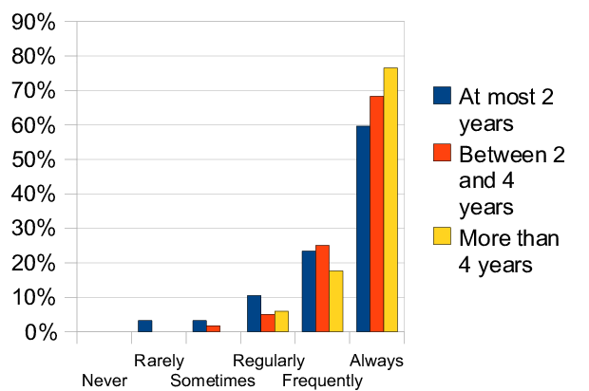
What do research studies say?
Issues
Metric definitions lack detail or unrepresentative
Limited scope and size of projects
Different language, environment, and domain context
Difficult to measure TDD adherence
Differences in programmer skill levels
"TDD improves code quality"
source: https://ieeexplore.ieee.org/document/5463691
Notes:
There are definitely some issues with the conducted research works on TDD
metrics used for describing the findings have not been either defined in detail or lack the quality attribute they should be presenting.
Another problem: small scope of many experiments consisted of small tasks
Different studies used different languages..
The environment and domain context not always specified
And it is also difficult to measure how well developers are following the TDD rules,
which has a big impact on how effective TDD is
Much of the inconsistency likely can be attributed to internal factors not fully described in the TDD trials.
Thus, TDD is bound to remain a controversial topic of debate and research.

Slide 24
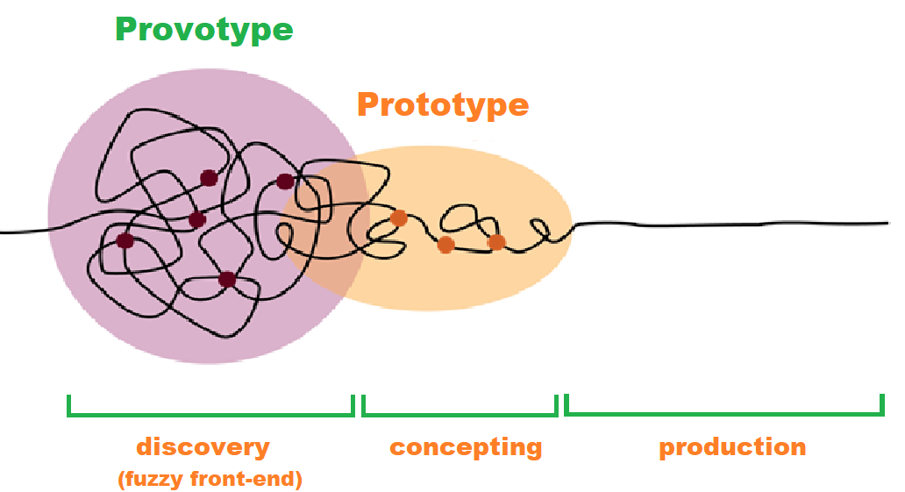
Limitations
“TDD helps with, but does not guarantee, good design and good code. Skill, talent, and expertise remain necessary”
- Esko Luontola
Not a panacea nor failproof
Steep learning curve, adapt mindest
Can be difficult to predict course
False sense of security
Difficult to use in some situations
Possible variation:
Code up fast prototypes for exploration to be thrown away (Spike)
Write down important test cases and observations
Notes:
TDD definitely has a number of limiations
First, TDD is not a panacea nor failproof,
it still relies a lot on skill and experience of the developer
TDD also has a steep learning curve and often requires developer to adapt a different mindset
Many experienced developers have a mental model of the system they are building, TDD might interfere with this
Can be difficult to predict course, more costly to throw away all tests when wrong, planning ahead too much
False sense of security, if the tests are not sound then test coverage has little value
Can be difficult to use in situations like GUIs, Relational Databases, Web Service

Slide 25
Designing for Testability
Notes:
Alright, now let's look at how we can make TDD more effective and also deal with real-world dependencies

Slide 26


The TDD process
Designing for Testability
External Dependencies
Real code has dependencies → break dependencies:
Hardware independence
Stand-in for expensive hardware
Inject difficult to produce inputs
Network failure
Speed up a slow collaborator
Database
Replace something under development
Software library
"Pull the plug now, Harry!"
Notes:
In the real world, our code often has external dependencies
Hardware independence: especially useful for embedded system where your board may not have arrived yet or you have limited access to hardware
It also allows us to inject inputs which are difficult to produce
For example if we want to simulate a network failure, we could ask our colleague to pull the plug at a very specific moment
However, this is hardly reproducible and can take a lot of time
Also may want to break dependance on a slow collaborator as the speed of our tests is important
we want our tests to run often and run fast
Lastly, you may want to replace something

Slide 27
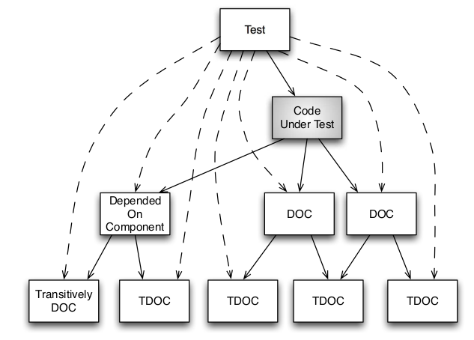
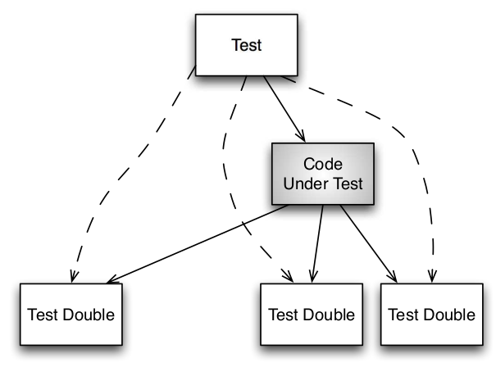
The TDD process
Designing for Testability
External Dependencies
Test Doubles:
Dummy, Stub, Spy, Mock, Fake
Allow us to independently test application code
Notes:
In order to break external dependencies we can use test doubles
We can replace our dependent-on-components with test doubles
This allows us to independently test the application code without relying on the any dependencies

Slide 28
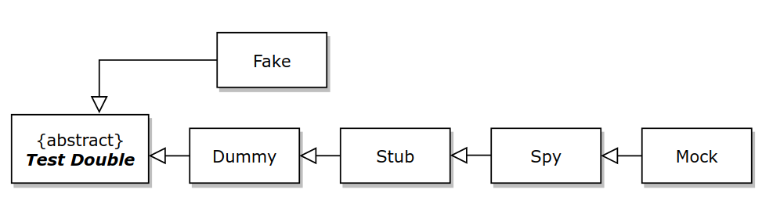
The TDD process
Designing for Testability
External Dependencies
Test Doubles
Simple
Dummy | Never called, allows program to compile
Stub | Returns a value as directed by test case
Spy | Returns a value and verifies parameters passed
Mock | Verifies function calls, call order, and parameters passed
Fake | Partial implementation of a real component
Complex
Notes:
There are some different definitions of test doubles going around but I am going to stick with these which are roughly ordered in terms of increasing complexity.
A stub is a very simple entry point that returns a value
Stub: e.g. last thrown exception
Fake: e.g. in-memory database

Slide 29
The TDD process
Designing for Testability
Mocking
Prescribe which calls to expect, then execute process
TEST(Flash, WriteSucceeds_ReadyImmediately)
{
MockIO_Expect_Write(CommandRegister, ProgramCommand);
MockIO_Expect_Write(address, data);
MockIO_Expect_ReadThenReturn(StatusRegister, ReadyBit);
MockIO_Expect_ReadThenReturn(address, data);
result = Flash_Write(address, data);
LONGS_EQUAL(FLASH_SUCCESS, result);
}

Slide 30
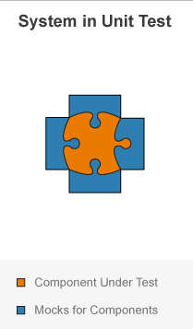
The TDD process
Designing for Testability
Mocking Challenges
Mocks should be simple
Complex mocks hard to read and maintain
Heavy mocking can lead to brittle tests
When implementation changes tests need update
Mocks can lead to overconfidence
Mocks may mask integration issues
Notes:
Complex mocks hard to read and maintain
Test setup becomes more complex
If the tests are heavily coupled to the tests, then tests need to be updated often
It's possible that mocks are hiding intergration issues
integration tests should still be included

Slide 31
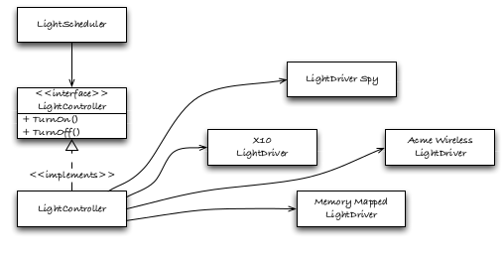
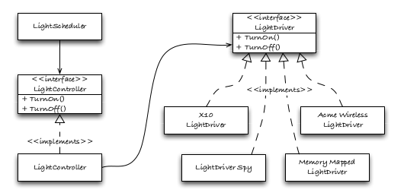
The TDD process
Designing for Testability
Interfaces
SOLID principles keep modules flexible and testable
Dependency Inversion, Open-Closed, Liskov Substitution
LightController should not know about concrete drivers
Notes:
With the former implementation on the left, every time we want to add a new driver we need to modify the light controller
But if we use an interface to decouple the lightcontroller from actual driver implementations, then it becomes easier to add new drivers in the future

Slide 32
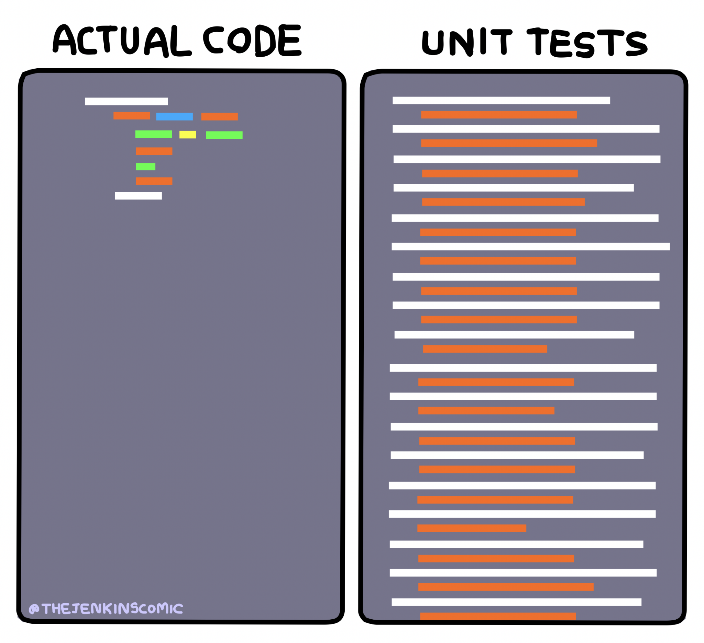
The TDD process
TDD Best Practices
Test-drive the interface before the internals
Tests should test a single concept
Focus on tests that increase confidence
Legacy code: add tests before modification
Notes:
Legacy code:
• Test-drive new code.
• Add tests to legacy code before modification.
• Test-drive changes to legacy code.
No ramble-on tests
we can test all numbers from 1 to 100 but gives little value

Slide 33
The TDD process
TDD Extensions
Extend TDD by involving different stakeholders
Acceptance Test-Driven Development
Collaboratively define acceptance tests
Focus on capturing the business requirements
Behaviour-Driven Development
Define system behaviour from perspective of stakeholders
Given-When-Then
TEST(LightScheduler, ScheduleOffWeekendAndItsSaturdayAndItsTime)
then
checkLightState(lightNumber, LIGHT_OFF);
Notes:
There are two variants with both extend TDD by putting more emphasis on involving different stakeholder such as customers, business analysts, testers
in ATDD developers and stakeholders define acceptance tests together
in BDD, the focus is more on the system behaviour from the stakeholders' pespective
Given that the schedule is turned off for the weekend
And when it's saturday
And when it's normally time to turn on the lights
Then lights should remain, because it's weekend

Slide 34
TDD for embedded systems
Dual target incompatibilities, extract common interface, adapter Pattern
Sometimes partiality manual test is needed, e..g. inspect led state
Show full system overview with HIL, CI, Map file, Ram usage etc
Breaking dependencies, e.g. pull network plug now!

Slide 35
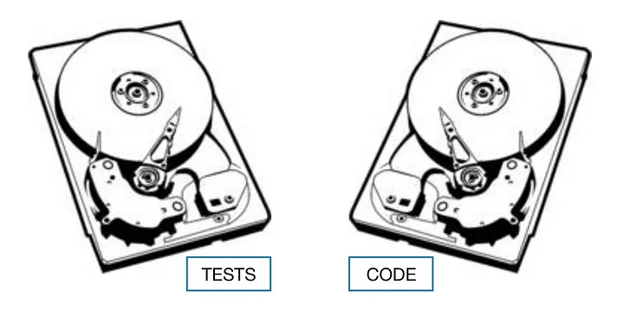

The Future of TDD with AI?
Use tests to communicate system requirements to AI
Allow non-technical people to specify desired behavior
The Two Disks Parable
https://drpicox.medium.com/the-two-disks-parable-ac1a16803c58
Notes:
Use tests to tweak behaviour
TESTS:
TDD. We wrote tests first, and tests created our code. Our code exists because of these tests, and we can repeat the process.
CODE:
But the code would be different. Uhm. Better? The second time that I write the code, I do it better. Let’s crash the CODE and let TESTS survive.

Slide 36
In Summary
TDD has potential but requires monitoring
Reliant on developer experience and motivation
No clear consensus regarding internal quality
Better suited for some contexts than others
Notes:
And while there is no clear consensus regarding internal quality, research does suggest several benefits of TDD including a decreased defect rate
In the end, we should keep in mind that TDD is better suited for some contexts than others

Slide 37
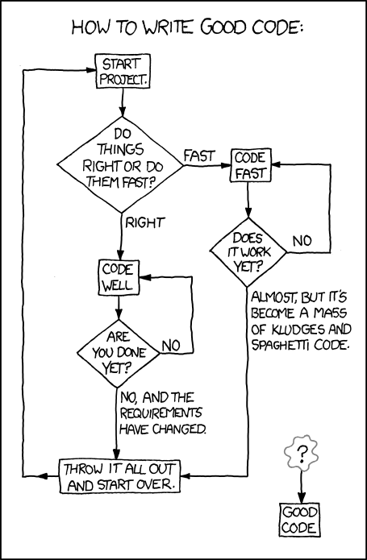
Questions!
TDD?

